Slide 1
Focus sull'importanza di una rete bariatrica nell'urgenza
AMANDA BELLUZZI
UOC Chirurgia Generale, OSPEDALE SANTA MARIA DELLA MISERICORDIA, ROVIGO

Slide 2
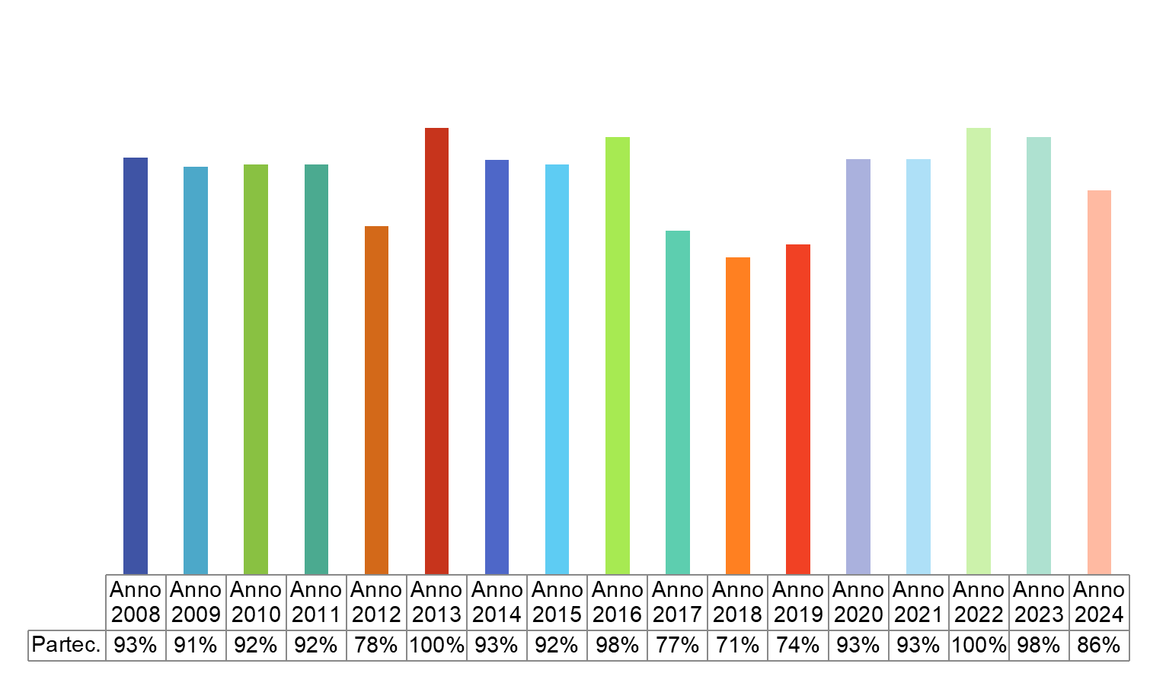
Focus sull'importanza di una rete bariatrica nell'urgenza
139 Centri SICOB hanno risposto all’indagine conoscitiva
Dati ufficiali SICOB aggiornati al 21 Gennaio 2024

Slide 3
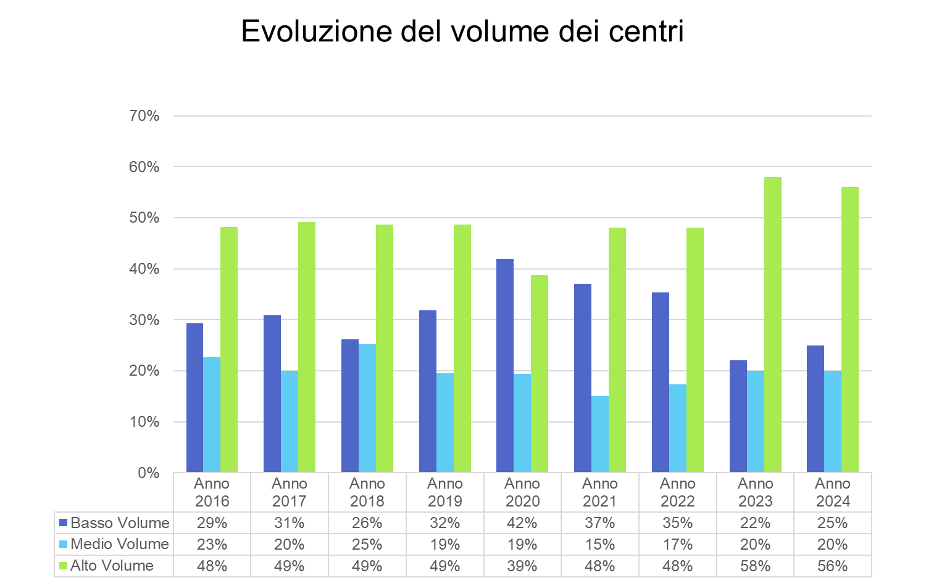
Focus sull'importanza di una rete bariatrica nell'urgenza
Dati ufficiali SICOB aggiornati al 21 Gennaio 2024

Slide 4
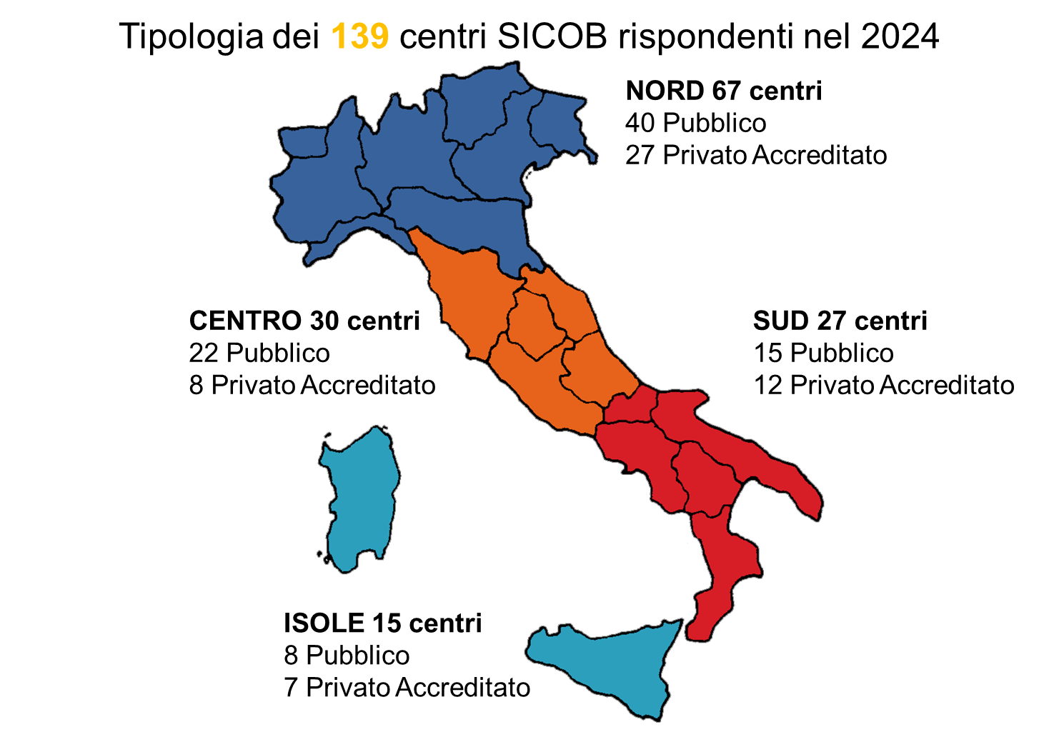
Focus sull'importanza di una rete bariatrica nell'urgenza
Dati ufficiali SICOB aggiornati al 21 Gennaio 2024

Slide 5
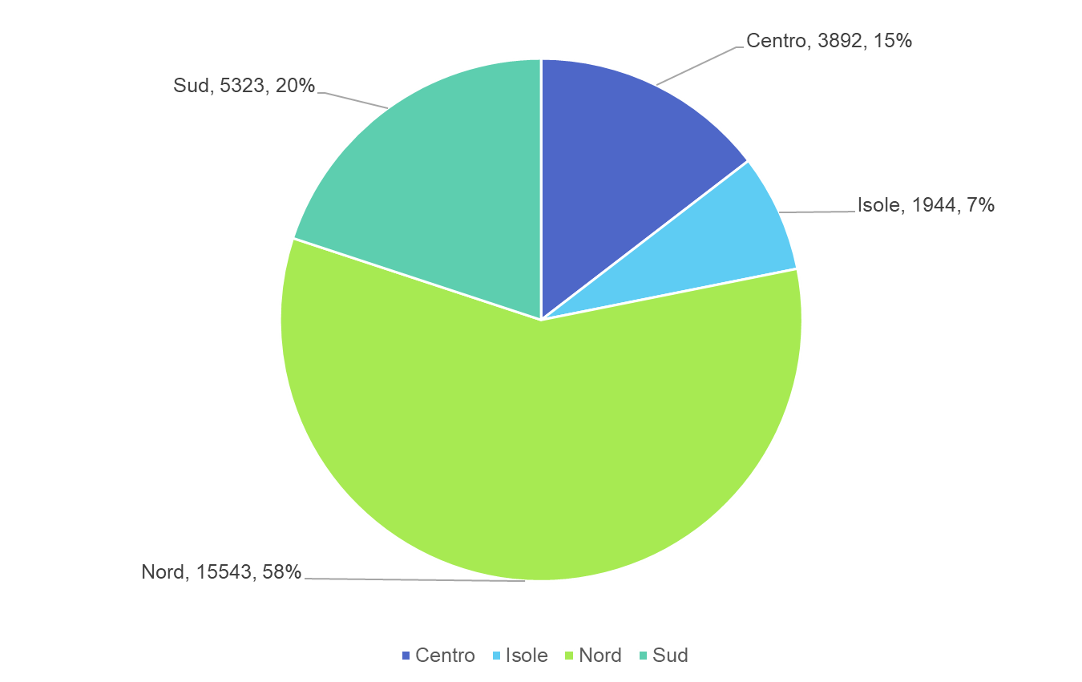
Focus sull'importanza di una rete bariatrica nell'urgenza
26.702 Interventi effettuati in Italia
Dati ufficiali SICOB aggiornati al 21 Gennaio 2024

Slide 6
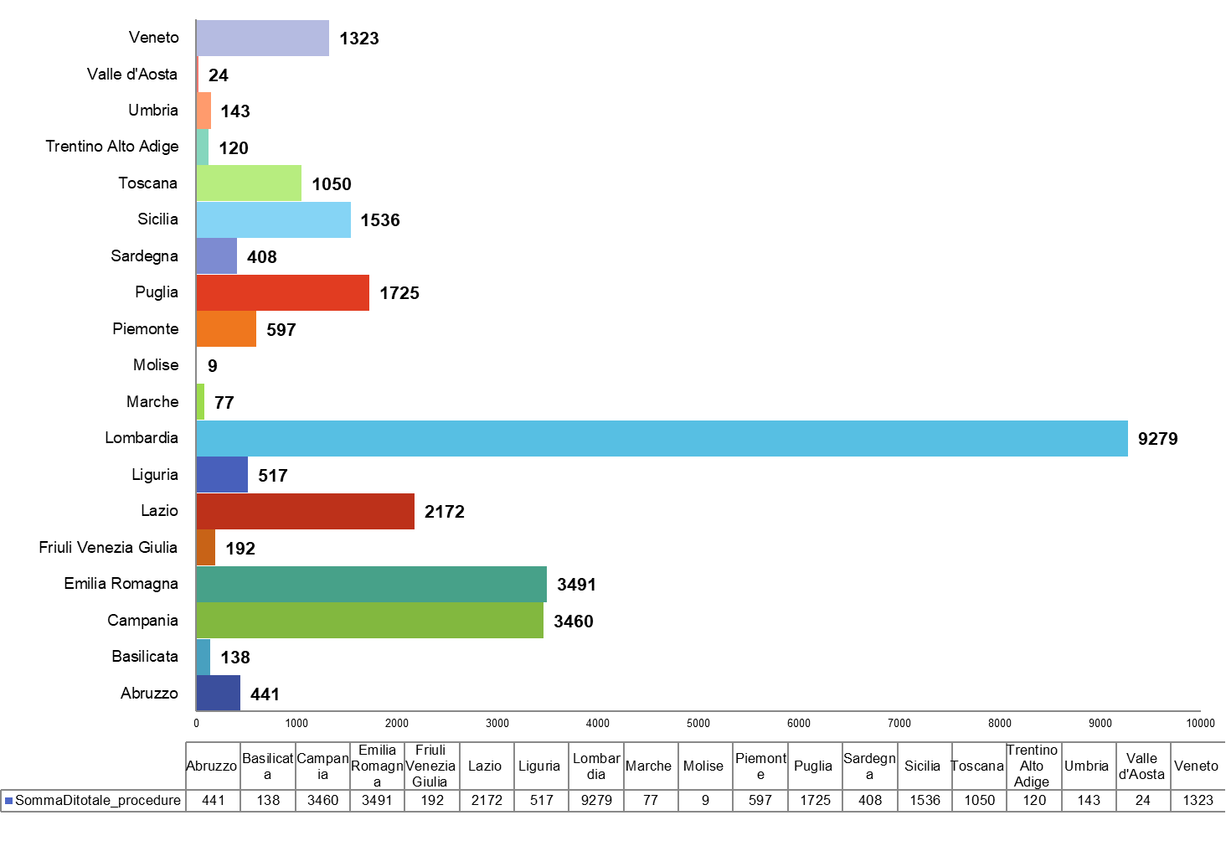
Focus sull'importanza di una rete bariatrica nell'urgenza
26.702 Interventi - Suddivisione per regione
Dati ufficiali SICOB aggiornati al 21 Gennaio 2024

Slide 7
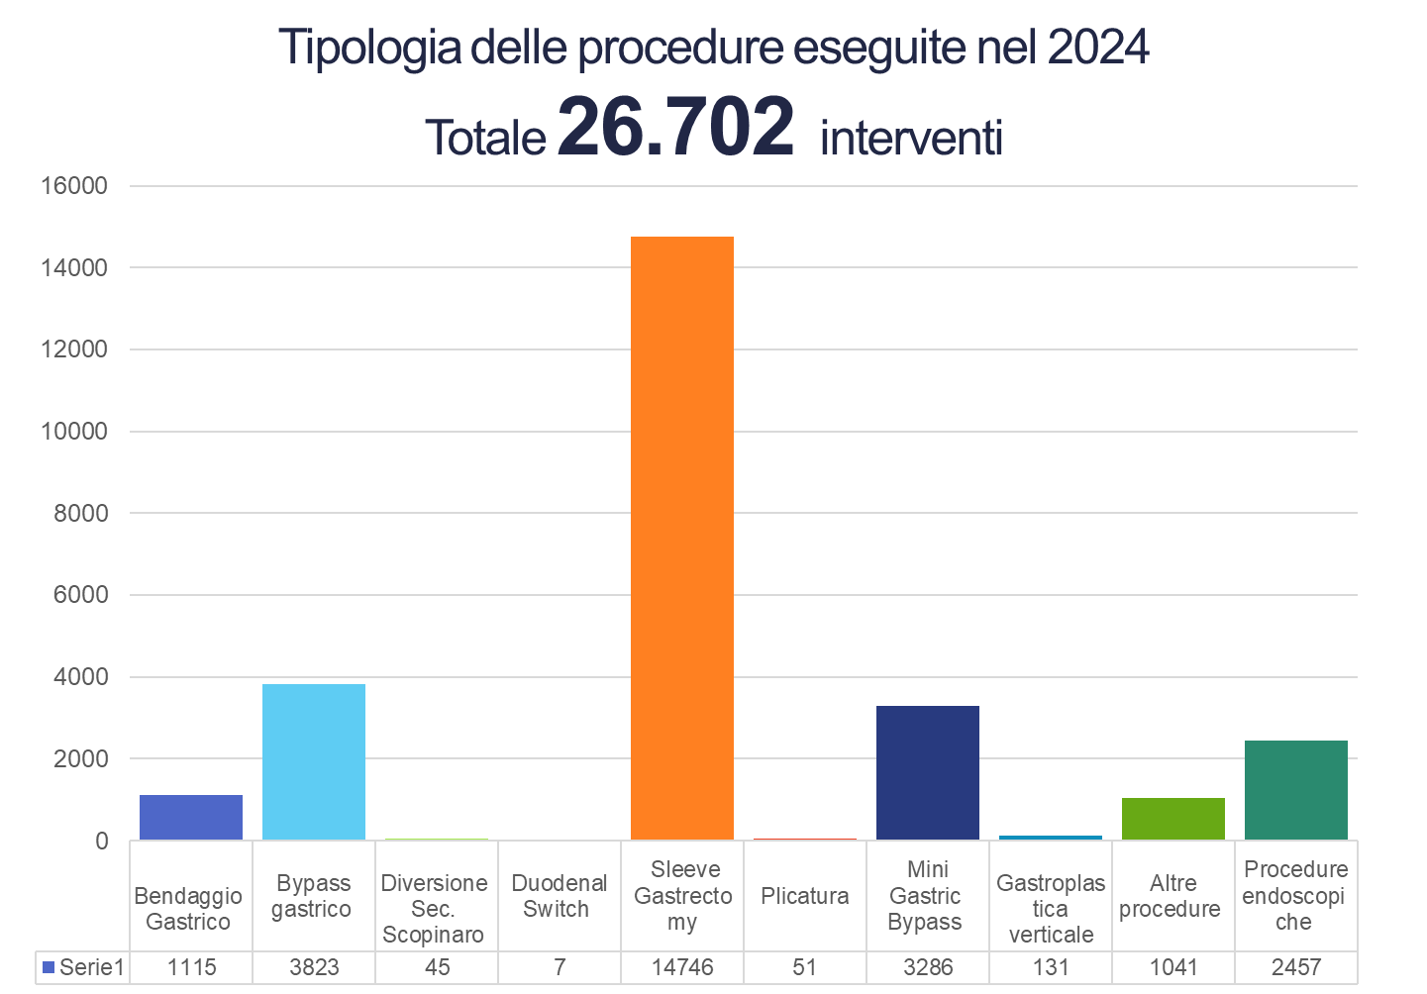
Focus sull'importanza di una rete bariatrica nell'urgenza

Slide 8

Focus sull'importanza di una rete bariatrica nell'urgenza
I nodi della rete bariatrica nell’urgenza
Multimodal Treatment
Informazione
Prevenzione
Ottimizzazione
Comunicazione
Consapevolezza
Formazione
Appropriatezza

Slide 9
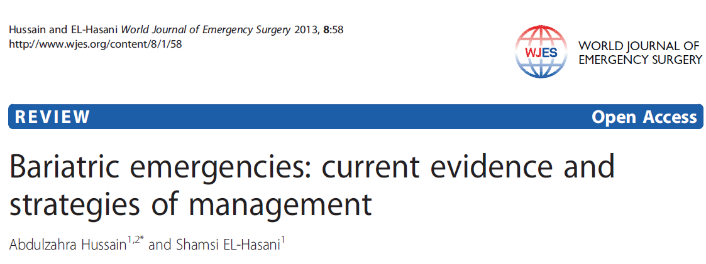
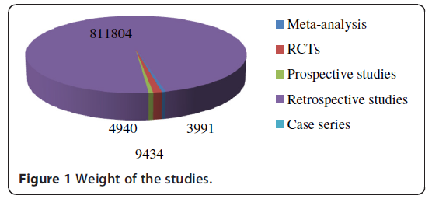
Focus sull'importanza di una rete bariatrica nell'urgenza
2013
Key points
The demand for MBS is increasing and the postoperative complications are seen more frequently.
MBS were increasingly seen in the Accident and Emergency departments, the serious outcomes were reported following MBS operations .
The causes were technical errors, suboptimal evaluation, failure of effective communication with bariatric teams who performed the initial operation, patients’ factors, and delay in the presentation.
The mortality ranged from 0.14%-2.2% and increased for revisional surgery to 6.5% (p = 0.002).
Pooled data of 830,998 patients-
Majority of the current body of knowledge was
reported by retrospective and observational studies
Hussain A, El-Hasani S. Bariatric emergencies: current evidence and strategies of management. World J Emerg Surg. 2013 Dec 29;8(1):58.

Slide 10
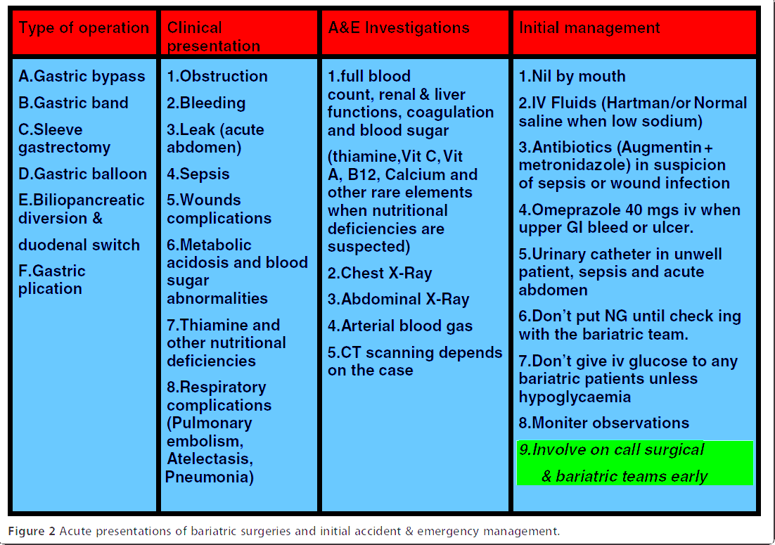
Focus sull'importanza di una rete bariatrica nell'urgenza
2013
Acute presentations of MBS surgeries and initial accident & emergency management
Hussain A, El-Hasani S. Bariatric emergencies: current evidence and strategies of management. World J Emerg Surg. 2013 Dec 29;8(1):58.

Slide 11
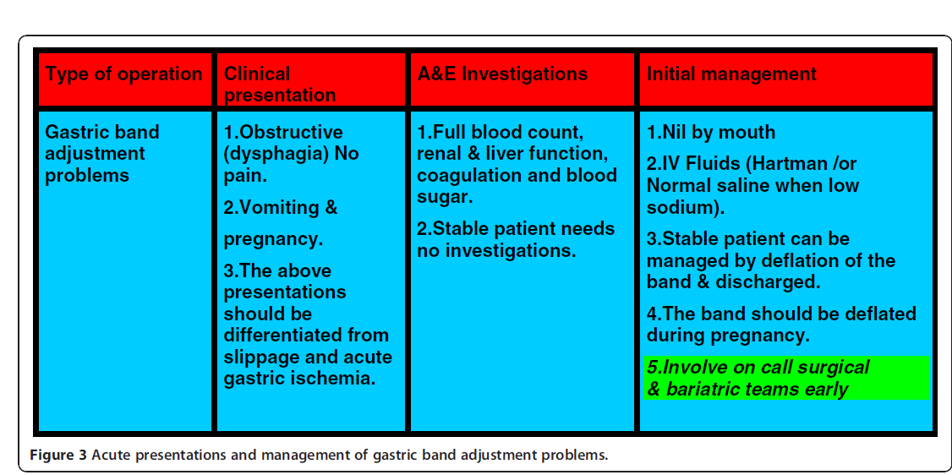
Focus sull'importanza di una rete bariatrica nell'urgenza
2013
Acute presentations and initial management of gastric band adjustment problems
Hussain A, El-Hasani S. Bariatric emergencies: current evidence and strategies of management. World J Emerg Surg. 2013 Dec 29;8(1):58.

Slide 12
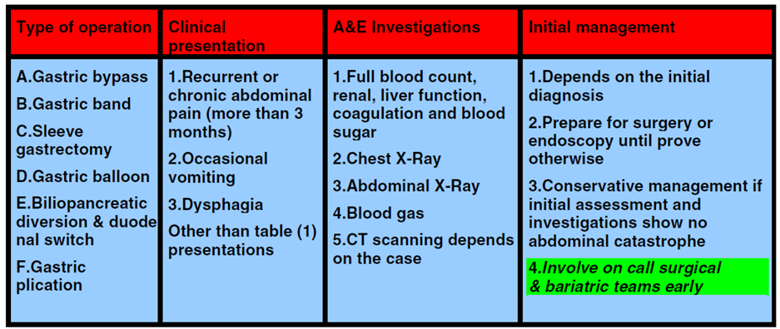
Focus sull'importanza di una rete bariatrica nell'urgenza
2013
Presentations and initial management of
chronic or subacute post-MBS complications which are seen
in Emergency Department
Hussain A, El-Hasani S. Bariatric emergencies: current evidence and strategies of management. World J Emerg Surg. 2013 Dec 29;8(1):58.

Slide 13
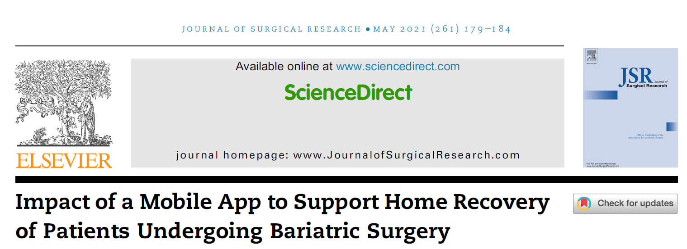
Focus sull'importanza di una rete bariatrica nell'urgenza
2021
A mobile app that provides bariatric patients with access to educational materials and the ability to report on their symptoms.
Using the data from the app and linking the data to patient outcomes collected in the Metabolic and Bariatric Surgery Accreditation and Quality Improvement Program database, we examined the effects of the app on readmission, length of stay, visits to the emergency department (ED), and patient satisfaction.
Additional features, such as the ability for patients to directly communicate with the health care providers within the app, may be effective in decreasing unnecessary health care utilization.
After the surgery, patients continued to have access to the educational materials in the resource library. In addition, patients were asked to answer questions about their symptoms in the Daily Health Check survey for 30 postoperative days. The questions asked patients about their postoperative symptoms in addition to self-care and adherence to their recovery program
Depending on the survey response, patients were advised if they were on-track or need to seek symptom management by reviewing self-care education through the resource library feature, by calling the clinical staff, or by visiting the ED.
Heuser J, Maeda A, Yang L, Masino C, Duggal S, Jackson T, Okrainec A. Impact of a Mobile App to Support Home Recovery of Patients Undergoing Bariatric Surgery. J Surg Res. 2021 May;261:179-184.

Slide 14
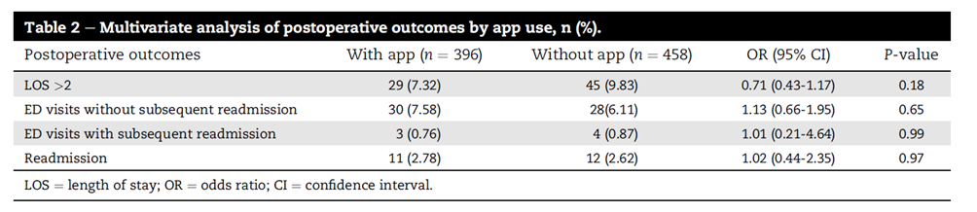
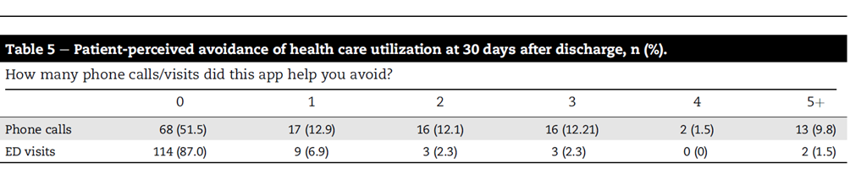
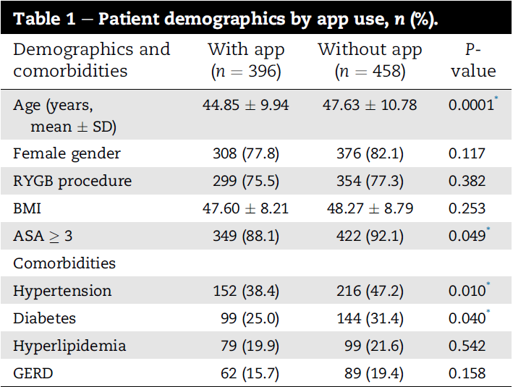
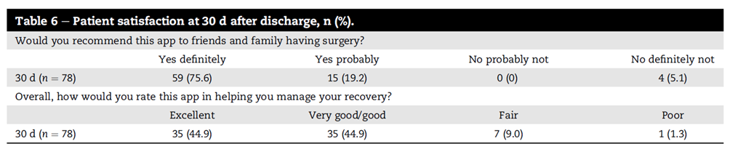
Focus sull'importanza di una rete bariatrica nell'urgenza
2021
While the app usage was not significantly associated with reductions in readmissions and ED visits, patients had a high level of satisfaction with the app and perceived that it helped avoid potentially unnecessary phone calls and hospital visits.
These findings suggest that the use of a mobile app in this patient population may help improve postoperative experience of patients and enable them to manage their symptom with the goal for a safer recovery at home
Heuser J, Maeda A, Yang L, Masino C, Duggal S, Jackson T, Okrainec A. Impact of a Mobile App to Support Home Recovery of Patients Undergoing Bariatric Surgery. J Surg Res. 2021 May;261:179-184.

Slide 15
Focus sull'importanza di una rete bariatrica nell'urgenza
2021
Perioperative patient education and engagement are critical components of care in patients undergoing bariatric surgery, given the short length of stay and the requirements to adhere to various instructions.
The use of patient engagement mobile technology may promote adherence to perioperative protocols and improve care by potentially identifying complications earlier and reducing associated health care costs.
Patient education, engagement, and adherence to prescribed protocol are key components of care in MBS patients.
Mobile technology may improve surgical outcomes by promoting patient adherence to perioperative protocols and enabling early identification of postoperative complications.
Heuser J, Maeda A, Yang L, Masino C, Duggal S, Jackson T, Okrainec A. Impact of a Mobile App to Support Home Recovery of Patients Undergoing Bariatric Surgery. J Surg Res. 2021 May;261:179-184.

Slide 16
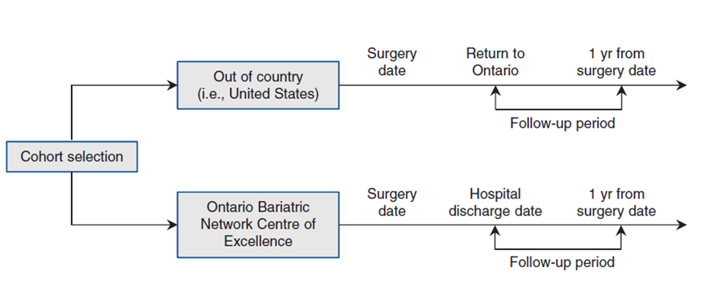
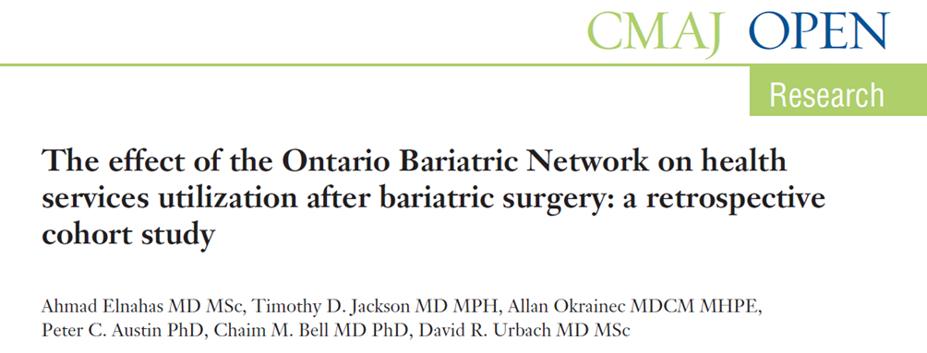
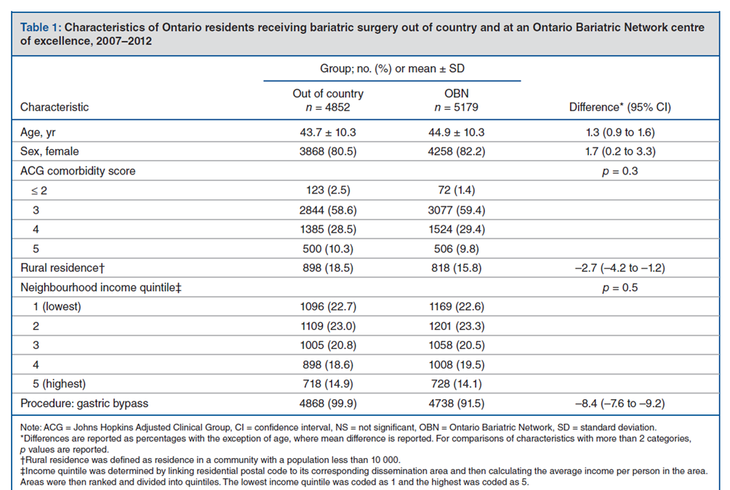
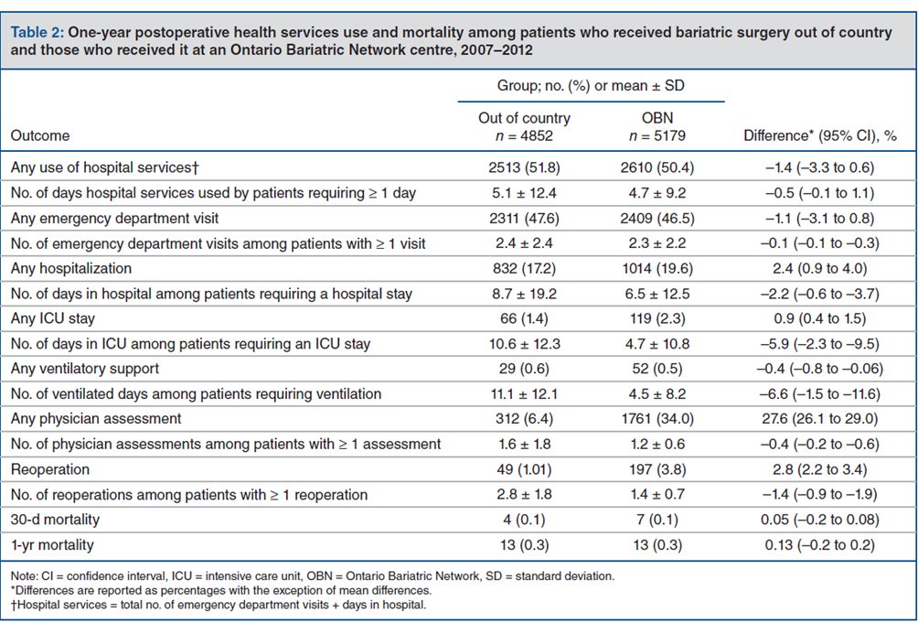
Focus sull'importanza di una rete bariatrica nell'urgenza
2016
Elnahas A, Jackson TD, Okrainec A, Austin PC, Bell CM, Urbach DR. The effect of the Ontario Bariatric Network on health services utilization after bariatric surgery: a retrospective cohort study. CMAJ Open. 2016 Sep 14;4(3):E489-E495.

Slide 17
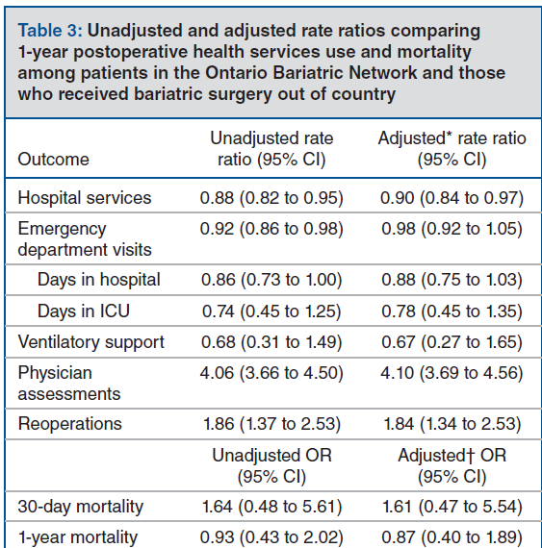
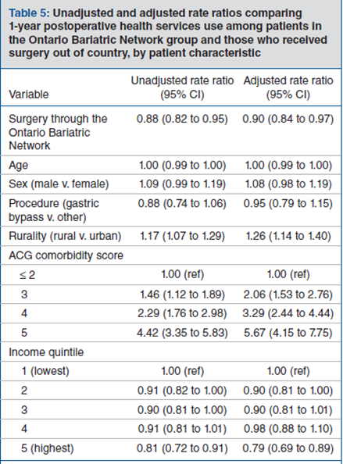
Focus sull'importanza di una rete bariatrica nell'urgenza
2016
In this study involving 10 031 patients, MBS at an Ontario Bariatric Network centre of excellence was associated with significantly less use of postoperative hospital services than out-of-country surgery.
This findings support the American Society for Metabolic and Bariatric Surgery’s position on global bariatric health care, which discourages “referral across international borders or long distances … for patients requesting bariatric surgery if a high-quality bariatric program is available locally.”
Implementing a comprehensive and multidisciplinary provincial bariatric program provided a better model of care than outsourcing bariatric surgical services by increasing outpatient care and reducing the use of postoperative hospital services
Elnahas A, Jackson TD, Okrainec A, Austin PC, Bell CM, Urbach DR. The effect of the Ontario Bariatric Network on health services utilization after bariatric surgery: a retrospective cohort study. CMAJ Open. 2016 Sep 14;4(3):E489-E495.

Slide 18
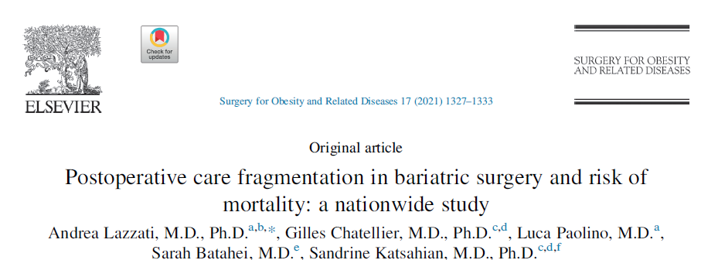
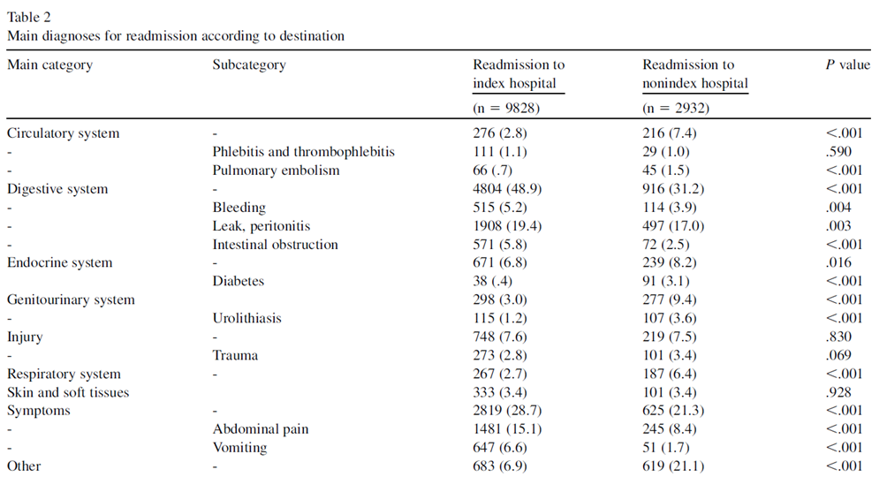
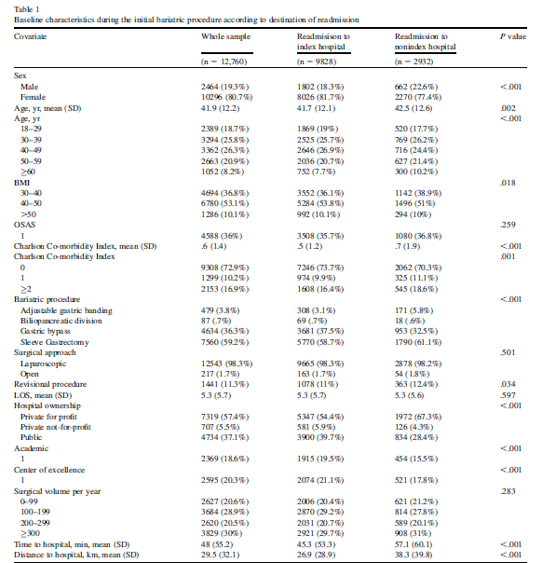
Focus sull'importanza di una rete bariatrica nell'urgenza
2021
Readmission after bariatric surgery may to lead to fragmentation of care if readmission occurs at a facility other than the index hospital. The effect of readmission to a nonindex hospital on postoperative mortality remains unclear for bariatric surgery.
In a cohort of 278,600 patients who received MBS, 12.760 (4.6%) were readmitted within 30 days. In cases of readmission, 23% of patients were admitted to a non-index hospital.
Lazzati A, Chatellier G, Paolino L, Batahei S, Katsahian S. Postoperative care fragmentation in bariatric surgery and risk of mortality: a nationwide study. Surg Obes Relat Dis. 2021 Jul;17(7):1327-1333.

Slide 19
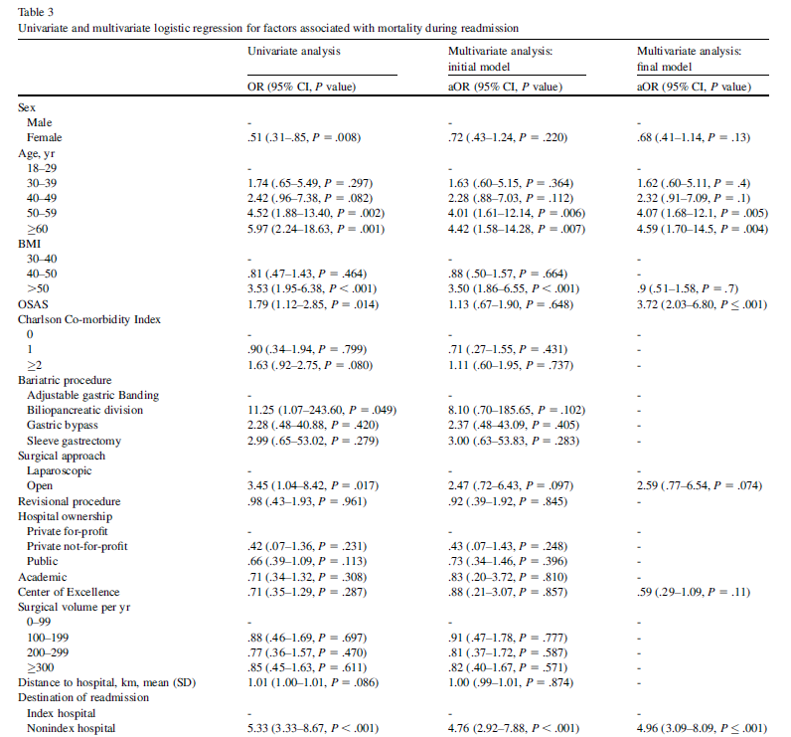
Focus sull'importanza di una rete bariatrica nell'urgenza
2021
Approximately one-fourth of readmissions after MBS were to non-index hospitals in this nationwide data set.
Non-index readmissions were associated with 5-fold higher odds of mortality compared with readmissions to index hospitals.
Being readmitted in a Center of Excellence in Obesity Care was an independent factor for better survival.
The index hospitals undoubtedly have more comprehensive information on a specific patient, permitting superior continuity of care.
The enhancement of information sharing through information technology is often suggested as a possible solution to the increasing problem of care fragmentation
Lazzati A, Chatellier G, Paolino L, Batahei S, Katsahian S. Postoperative care fragmentation in bariatric surgery and risk of mortality: a nationwide study. Surg Obes Relat Dis. 2021 Jul;17(7):1327-1333.

Slide 20
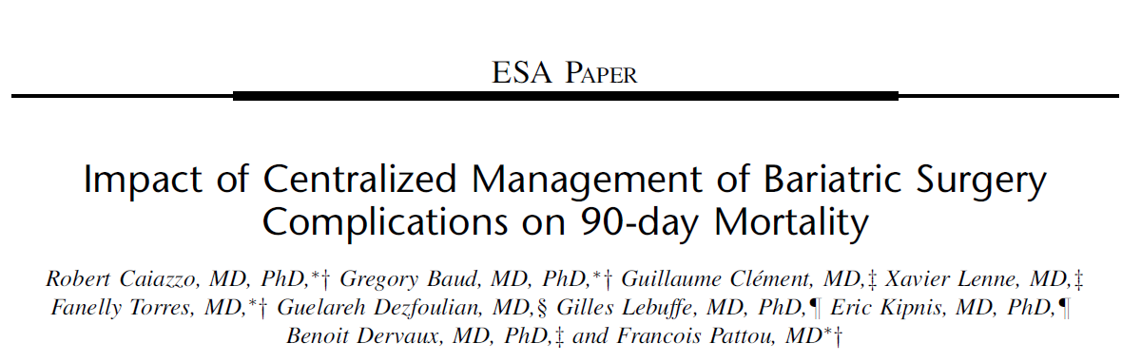
Focus sull'importanza di una rete bariatrica nell'urgenza
2018
The centralization of care for postoperative complication after BS implemented by French Authorities in 2013 in the Nord-Pas-de-Calais Region, France➔formalized network (OSEAN), coordinated by 1 tertiary referral center, enrolled all regional institutions performing MBS
3 principles
the 24/7 availability of a senior MBS surgeon from the referral center to provide distant mentoring or to organize, when necessary, emergency transfers.
the attendance by all surgeons of participating centers to regional Morbidity and Mortality Reviews organized twice a year for providing an open, collaborative, and transparent review process to examine practices and identify areas of improvement.
the re-referral of the patient to the center that performed the initial surgery after completion of treatment(s) for complication(s).
Caiazzo R, Baud G, Clément G, Lenne X, Torres F, Dezfoulian G, Lebuffe G, Kipnis E, Dervaux B, Pattou F. Impact of Centralized Management of Bariatric Surgery Complications on 90-day Mortality. Ann Surg. 2018 Nov;268(5):831-837.

Slide 21
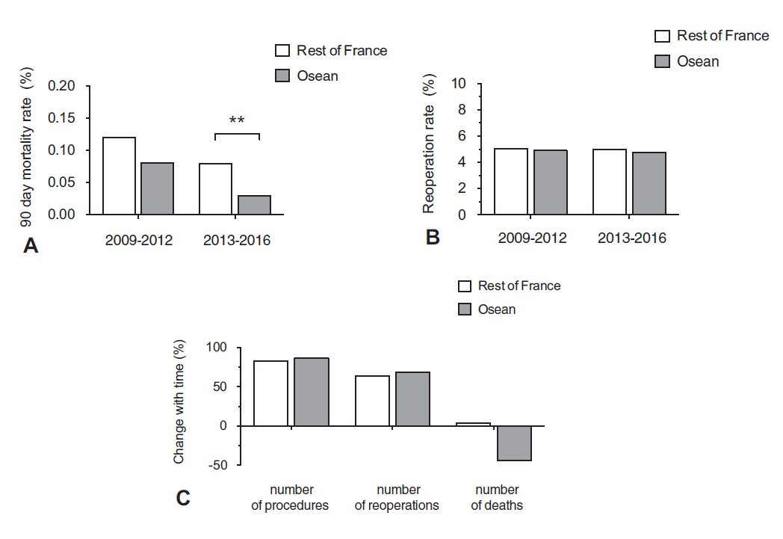
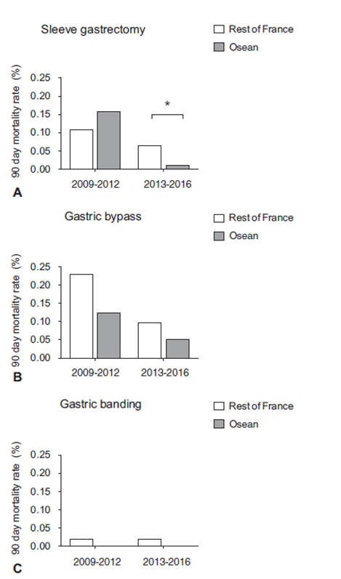
Focus sull'importanza di una rete bariatrica nell'urgenza
2018
In this pre–post analysis of all patients who underwent BS in France between 2009 and 2016, the implementation of an organization aiming at centralizing the management of postoperative complications in the Nord-Pas-de-Calais region was associated with a reduction of the overall 90-day mortality rate.
Conversely, the 90-day reoperation rate remained unchanged, suggesting that this organization positively impacted the management of complications rather than their incidence.
One alternative to the overall centralization of BS could be a selective centralization based on patient characteristics. Controlling risks by selecting patients and adapting hospital expertise to patients’ comorbidities or health status should improve outcome and reduce mortality.
Therefore, selecting patients who would be operated in less expert centers close to their home if this is their choice, based on their mortality risk factors, could be an option. The other patients with more risk factors should be oriented toward COE.
Caiazzo R, Baud G, Clément G, Lenne X, Torres F, Dezfoulian G, Lebuffe G, Kipnis E, Dervaux B, Pattou F. Impact of Centralized Management of Bariatric Surgery Complications on 90-day Mortality. Ann Surg. 2018 Nov;268(5):831-837.

Slide 22
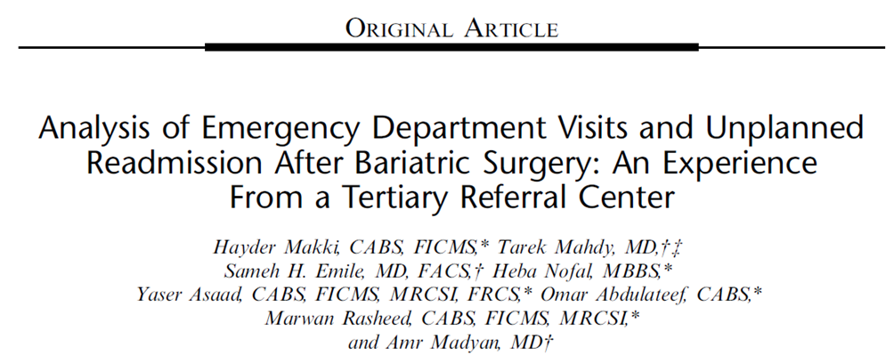
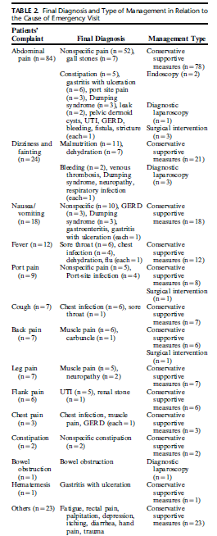
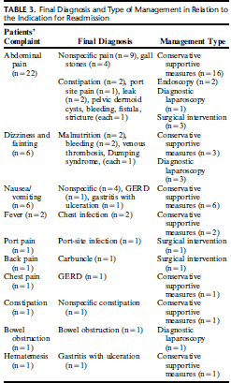
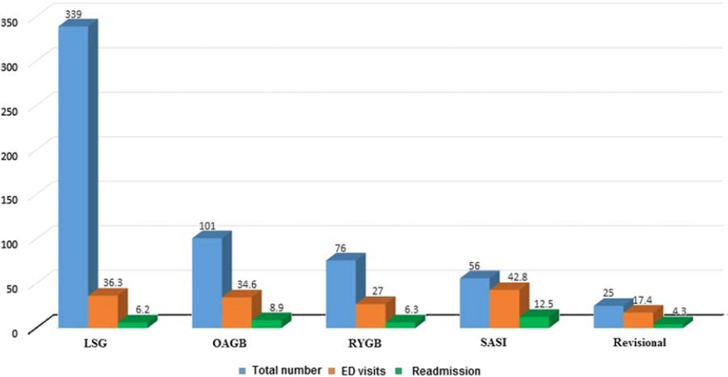
Focus sull'importanza di una rete bariatrica nell'urgenza
2021
Makki H, Mahdy T, Emile SH, Nofal H, Asaad Y, Abdulateef O, Rasheed M, Madyan A. Analysis of Emergency Department Visits and Unplanned Readmission After Bariatric Surgery: An Experience From a Tertiary Referral Center. Surg Laparosc Endosc Percutan Tech. 2021 Oct 14;32(1):107-113.

Slide 23
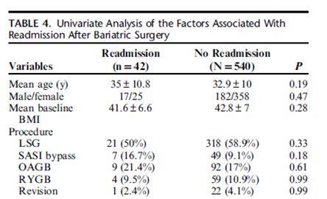
Focus sull'importanza di una rete bariatrica nell'urgenza
2021
2/3 of the indications for ED visits after MBS were not related to MBS per se and 94% required simple conservative measures. Similarly, 43% of readmissions were not related to bariatric surgery adverse effects and >70% were managed conservatively.
To decrease the current rates of ED visits and readmission, a number of strategies can be employed.
patient education programs based on the contributions of multidisciplinary team
patients should be informed about possible symptoms they may experience after discharge and should be informed about the warning signs of serious surgical and medical emergencies that warrant immediate medical care.
providing some type of virtual communication through a hotline or internet-based applications may help in preliminary screening of patients, thus patients with concerning symptoms are invited to visit the ED immediately whereas those with minor complaints can be counselled by telephone.
Makki H, Mahdy T, Emile SH, Nofal H, Asaad Y, Abdulateef O, Rasheed M, Madyan A. Analysis of Emergency Department Visits and Unplanned Readmission After Bariatric Surgery: An Experience From a Tertiary Referral Center. Surg Laparosc Endosc Percutan Tech. 2021 Oct 14;32(1):107-113.

Slide 24
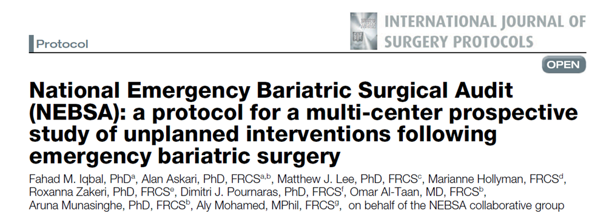

Focus sull'importanza di una rete bariatrica nell'urgenza
2025
The National Emergency Bariatric Surgical Audit (NEBSA) is poised to significantly enhance the current understanding of emergency bariatric surgery practiced across the UK.
Preliminary indications suggest that NEBSA will illuminate key aspects of patient demographics, engagement with NHS obesity pathways, and the choice between NHS-funded and self-funded bariatric surgery. By meticulously documenting surgical interventions and outcomes.
This study is expected to offer valuable insights into current trends and practices of the management of MBS complications nationwide.
This information could be pivotal in shaping future policy and clinical guidelines to optimize patient care in this rapidly evolving field. By leveraging the collective expertise and data from numerous centres, NEBSA aims to identify best practices and highlight areas experiencing significantly higher rates of intervention.
The findings from this audit are expected to catalyze discussions at national forums, thereby informing strategies to bridge knowledge gaps and enhance the overall quality of MBS care.
Iqbal FM, Askari A, Lee MJ, Hollyman M, Zakeri R, Pournaras DJ, Al-Taan O, Munasinghe A, Mohamed A. National Emergency Bariatric Surgical Audit (NEBSA): a protocol for a multi-center prospective study of unplanned interventions following emergency bariatric surgery. Int J Surg Protoc. 2025 Mar 20;29(2):63-67.

Slide 25
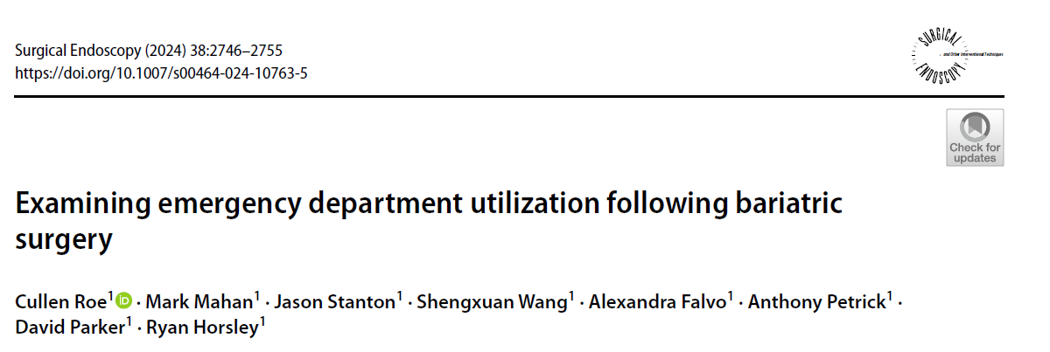
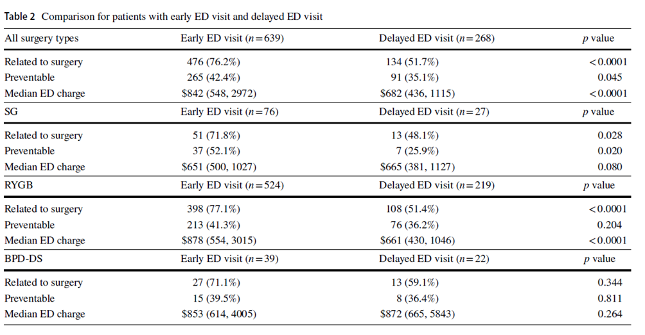


Focus sull'importanza di una rete bariatrica nell'urgenza
2025
Emergency department (ED) utilization following surgery is poorly understood and places immense strain on the healthcare system, being responsible for up to $38 billion in wasteful spending annually.
The aim of this study was to quantify ED utilization following bariatric procedures to identify causes and areas of improvement.
Of the 4703 patients that underwent MBS, 907 (19.3%) visited the ED at least once within 90 days and 350 (7.4%) required hospital readmission.
Under 50% of patients called prior to ED presentation and 61% of these ED visits resulted in discharge.
ED utilization after MBS constitutes a considerable burden, both in quality of patient care and financial costs.
Over half of MBS patients seen in the ED did not require hospital readmission. Improving ED utilization provides a significant opportunity to reduce the stress on an already hampered system.
Roe C, Mahan M, Stanton J, Wang S, Falvo A, Petrick A, Parker D, Horsley R. Examining emergency department utilization following bariatric surgery. Surg Endosc. 2024 May;38(5):2746-2755.

Slide 26
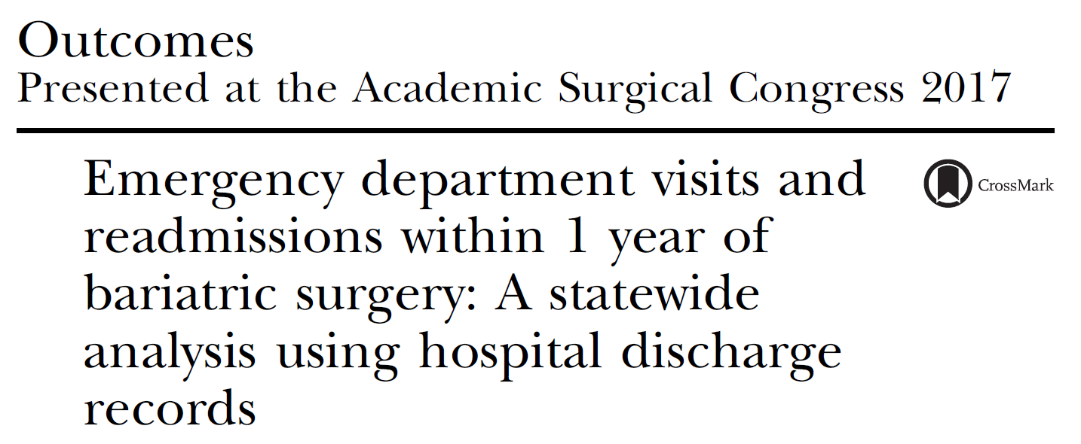
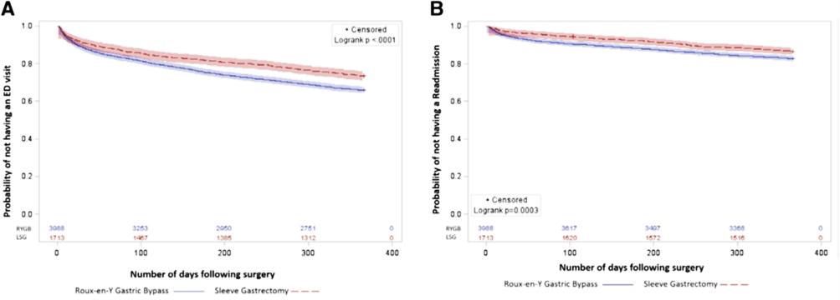
Focus sull'importanza di una rete bariatrica nell'urgenza
2017
ED visit
Readmission
Within 1 year of MBS, 36.9% of emergency department visits and 60.3% of readmissions were to the same institution in which bariatric surgery was performed.
The frequency of emergency department visits ranged from 10.7% (postoperative days 0–30) to 5.7% (postoperative days 181–270).
Readmission rates ranged from 4.4% (postoperative days 0–30) to 2.7% (postoperative days 91–180).
There were 5,161 visits from 2,245 patients (39% of the total cohort) within 1 year of bariatric surgery. Of these, 3,729 were ED visits without an inpatient stay and 1,432 were readmissions. Of those who visited the ED, 16.4% were subsequently admitted.
Mora-Pinzon MC, Henkel D, Miller RE, Remington PL, Gould JC, Kothari SN, Funk LM. Emergency department visits and readmissions within 1 year of bariatric surgery: A statewide analysis using hospital discharge records. Surgery. 2017 Nov;162(5):1155-1162.

Slide 27
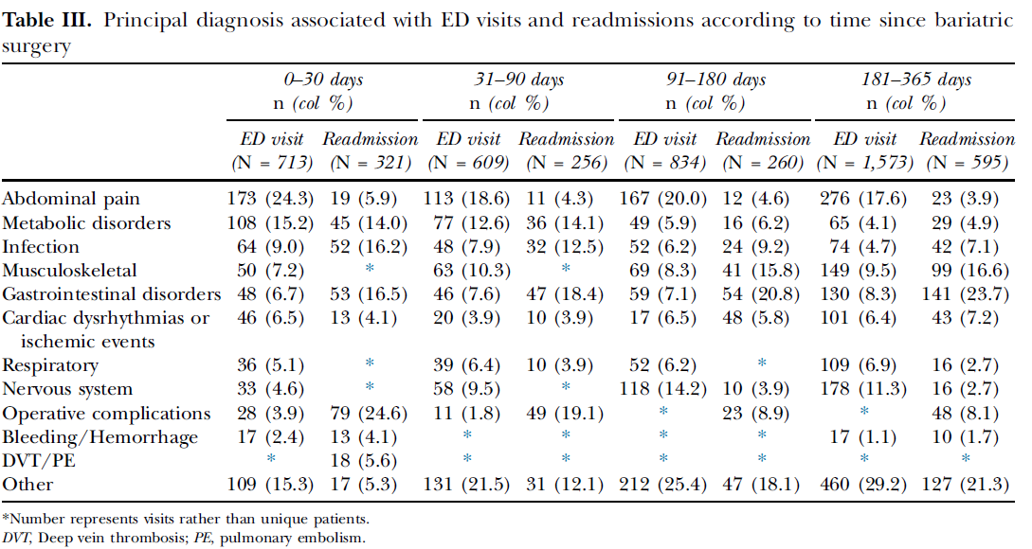
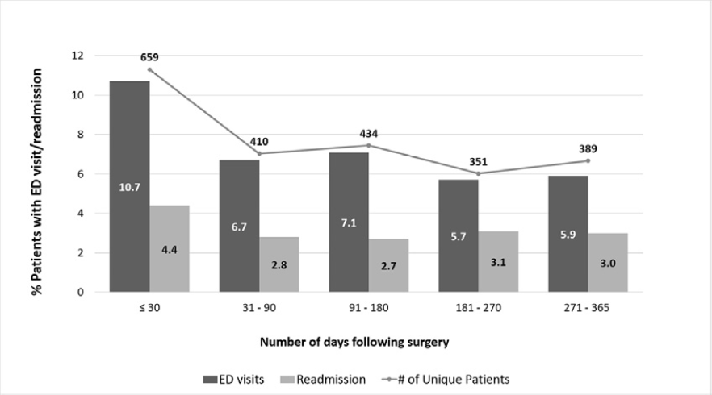
Focus sull'importanza di una rete bariatrica nell'urgenza
2017
Distribution of ED visits/readmissions during the first year after bariatric surgery
Frequency of ED visits/readmissions that occurred at the same institution where MBS surgery was performed
Mora-Pinzon MC, Henkel D, Miller RE, Remington PL, Gould JC, Kothari SN, Funk LM. Emergency department visits and readmissions within 1 year of bariatric surgery: A statewide analysis using hospital discharge records. Surgery. 2017 Nov;162(5):1155-1162.

Slide 28
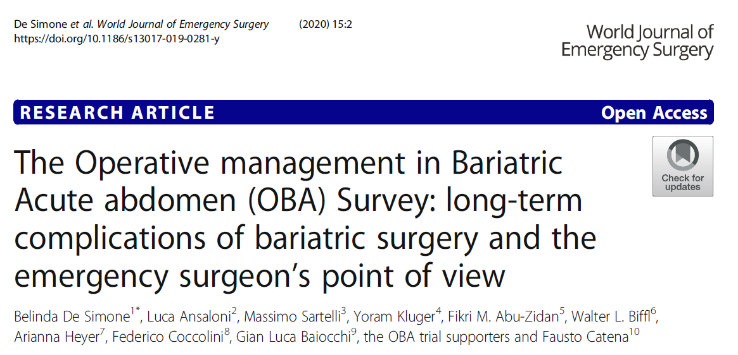
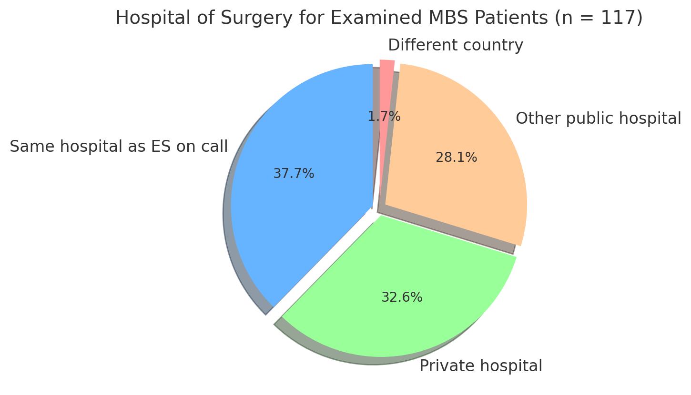
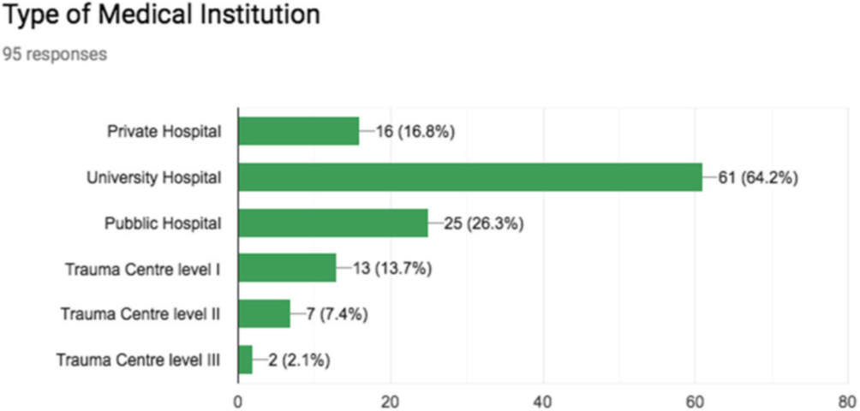
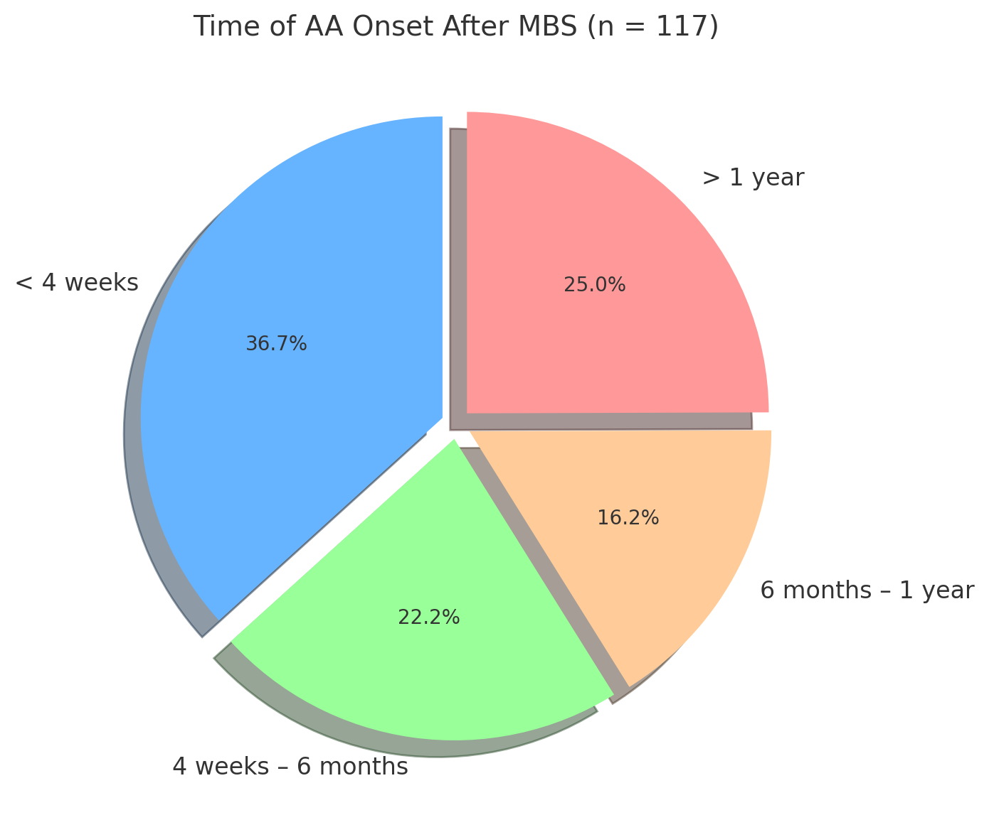
Focus sull'importanza di una rete bariatrica nell'urgenza
2020
An international web survey was sent to 197 emergency surgeons with the aim to collect data about emergency surgeons’ experience in the management of patients admitted in the ED for acute abdominal pain after MBS.
ANSWERS
De Simone B, Ansaloni L, Sartelli M, Kluger Y, Abu-Zidan FM, Biffl WL, Heyer A, Coccolini F, Baiocchi GL; OBA trial supporters; Catena F. The Operative management in Bariatric Acute abdomen (OBA) Survey: long-term complications of bariatric surgery and the emergency surgeon's point of view. World J Emerg Surg. 2020 Jan 6;15(1):2.

Slide 29
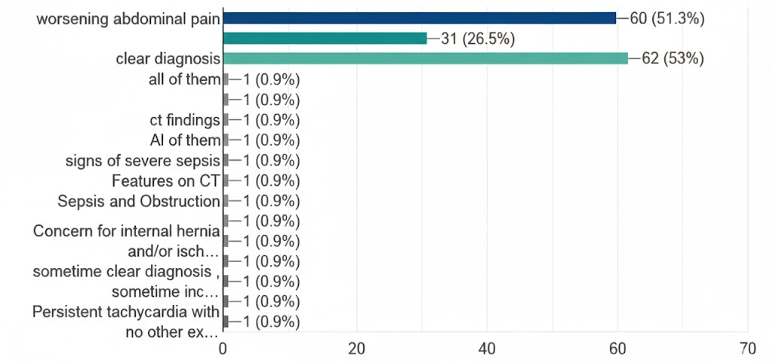
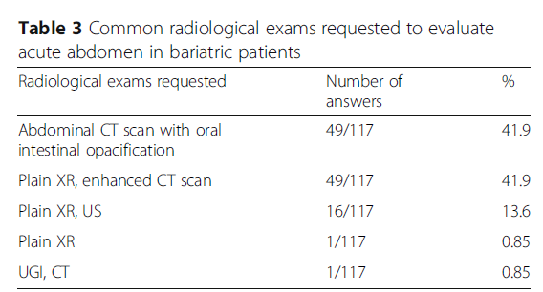
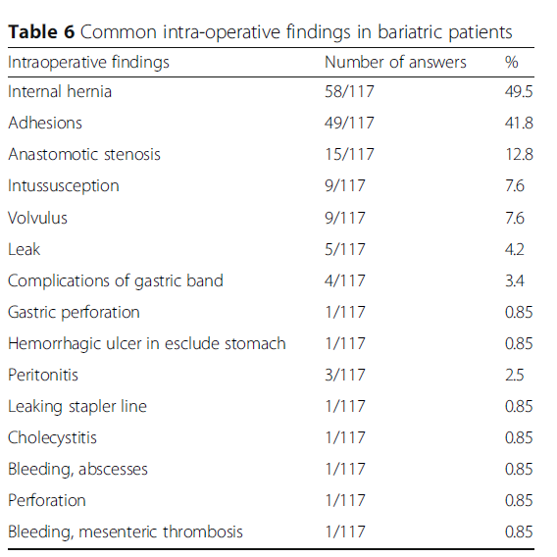
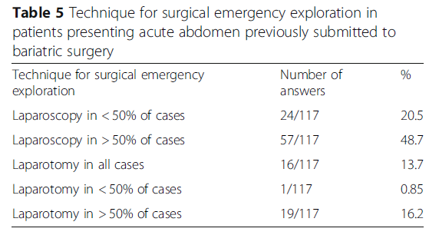
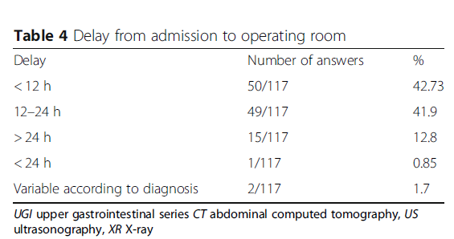
Focus sull'importanza di una rete bariatrica nell'urgenza
2020
Why do you decide to take the patients to the OR?
De Simone B, Ansaloni L, Sartelli M, Kluger Y, Abu-Zidan FM, Biffl WL, Heyer A, Coccolini F, Baiocchi GL; OBA trial supporters; Catena F. The Operative management in Bariatric Acute abdomen (OBA) Survey: long-term complications of bariatric surgery and the emergency surgeon's point of view. World J Emerg Surg. 2020 Jan 6;15(1):2.

Slide 30


Focus sull'importanza di una rete bariatrica nell'urgenza
2020
72.6% of ES declared to be worried when asked to manage acute abdomen in patients with a previous history of MBS. This indicates the ES’ desire to be familiar with the various types of MBS, to understand the new anatomy, radiological findings, and long-term bariatric complications, to be able to appropriately manage them in the emergency setting.
Emergency surgeons must be mindful of postoperative MBS complications.
De Simone B, Ansaloni L, Sartelli M, Kluger Y, Abu-Zidan FM, Biffl WL, Heyer A, Coccolini F, Baiocchi GL; OBA trial supporters; Catena F. The Operative management in Bariatric Acute abdomen (OBA) Survey: long-term complications of bariatric surgery and the emergency surgeon's point of view. World J Emerg Surg. 2020 Jan 6;15(1):2.

Slide 31





Focus sull'importanza di una rete bariatrica nell'urgenza
2025
“In a country with a strained surgical workforce but also a patient population that values surgical specialization, the question of whether a general surgeon can and should handle an emergency surgery or a surgical complication that may fall into the scope of specialist is not uncommon”.
“This is where the art of medicine comes into play—what is that time cutoff? Surgeons love to have rules, spreadsheets, and flow charts that tell us exactly what to do and when to do it, but those do not always exist. Is the specialist an hour away or 5 hours away? Can surgery safely be delayed? You need to weigh all the factors, and it's difficult because there is often not one right answer,”
“Surgery is incredibly resource-intensive, so access to these resources—which includes surgeons themselves—is paramount. But resources are not distributed equally, and not all practice settings are created the same. “It's not just the skills of cutting and sewing,” Dr. Raines said. “In fact, the cutting and sewing is usually the easy part. It's the resources around it that can really make a difference.
“The number of MBS patients is rising astronomically, while the number of MBS surgeons is not. With complications relatively high in this population, patients are going to need specialty care, and either more specialists will need to be trained or surgeons are going to need to be able to be familiar with those conditions,”
“There are very busy general surgeons who went through residency when bariatric surgery was not performed at such high volumes as it is now, but does that absolve them from the responsibility of knowing how to take care of bariatric anatomy? No, they are just as responsible as a fresh graduate. That's when providing ongoing education pathways becomes important,”

Slide 32



Focus sull'importanza di una rete bariatrica nell'urgenza
2025
2022
Creating the blueprint of the steps that need to be taken to ensure the patient has both the best care for their acute process and the surgical care to get into the tertiary center where they can do the definitive care can be a critical step in saving a life. That will require efficient and effective communication.
“We need to have a way of connecting both groups and everyone being okay with saying, ‘Based on what you're telling me, this is how we would handle it.
“Our patients need surgeons to specialize in order to drive better outcomes, but we need more and more bridges built between these specialties so that everyone is connected to provide the best care at the right time,”
“At the end of the day, the only thing that really matters is not the specialization—it is doing what is right for the patient.”

Slide 33


Focus sull'importanza di una rete bariatrica nell'urgenza
Take home messages
General surgeons and emergency doctors must be familiar with new post-bariatric anatomy and its possible complications since some of these require life-saving surgery in emergency conditions and do not allow the patient to be transferred to a bariatric center.
As the prevalence of MBS procedures escalates, the establishment of a dedicated, prospective complication registry becomes imperative. Such an initiative would facilitate a nuanced understanding of bariatric surgical emergency (BSE) within the current healthcare milieu, enhance economic evaluations, elucidate long-term patient outcomes, and inform requisite adjustments in professional training.
The enhancement of information sharing through information technology is often suggested as a possible solution
to the increasing problem of care fragmentation.

Slide 34

Grazie
“Surgeons who did not give constant and vigilant attention to
particulars in their practice, or who did not seek to improve performance, were failing in their duty to patients and letting down their profession’
Joseph Lister

